Slide 1
Breast and Prostate Cancer
By Dr Justin Copitch

Slide 2
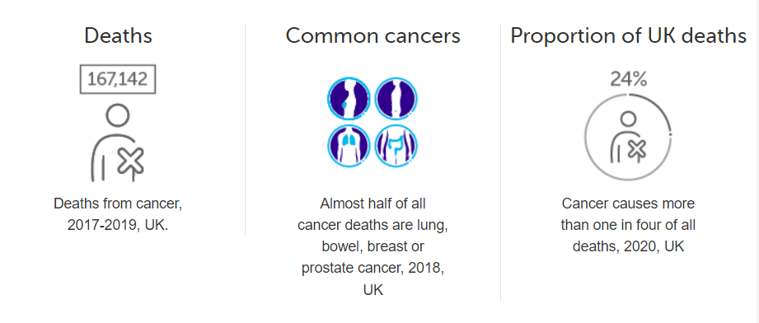
Why is cancer an important topic?

Slide 3
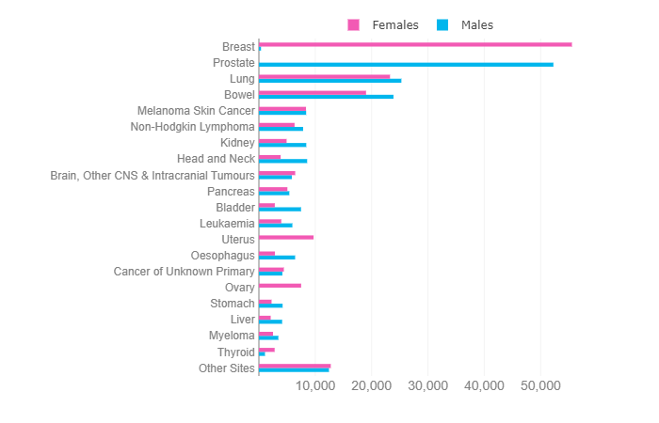
Cancer Incidence 2017-2019 UK

Slide 4
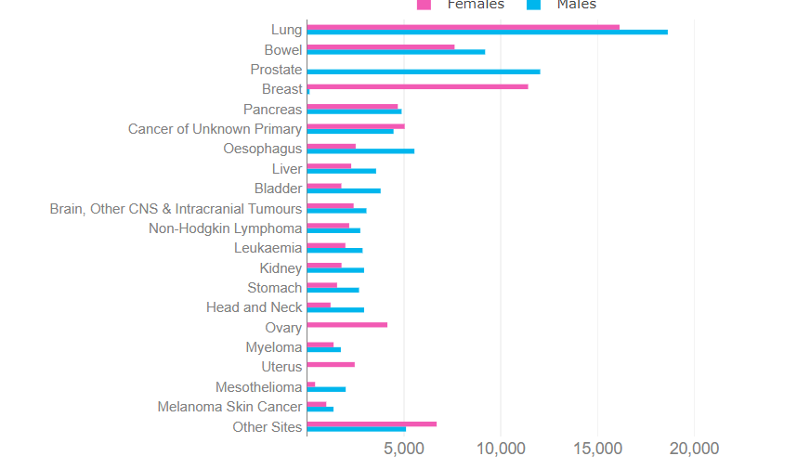
Cancer Mortality 2017-2019 UK

Slide 5
What do you notice
Incidence Mortality

Slide 6
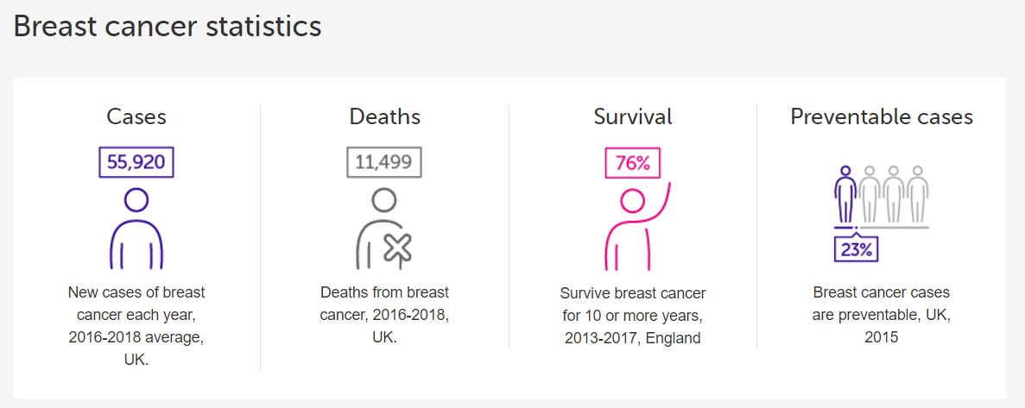
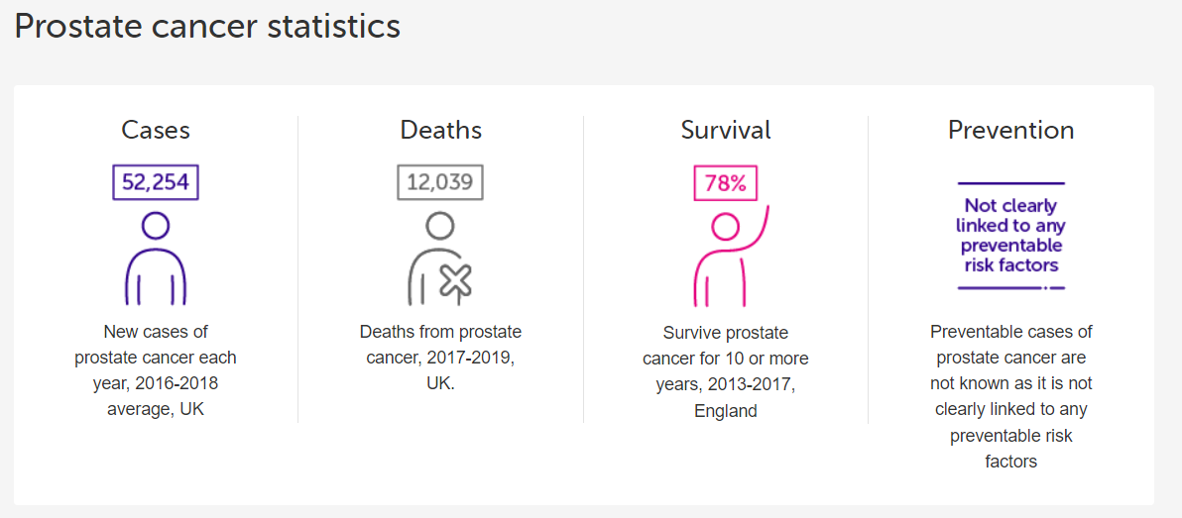

Slide 7
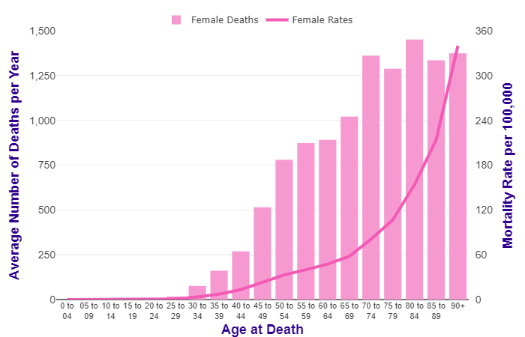
Age of deaths

Slide 8
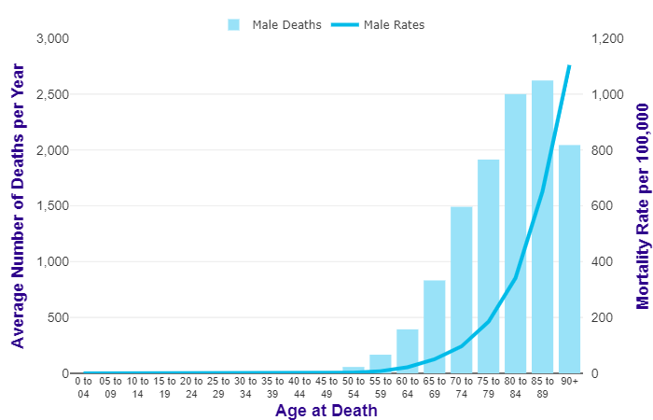
Age of deaths

Slide 9
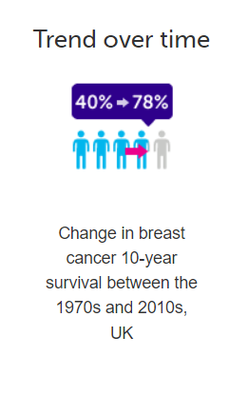
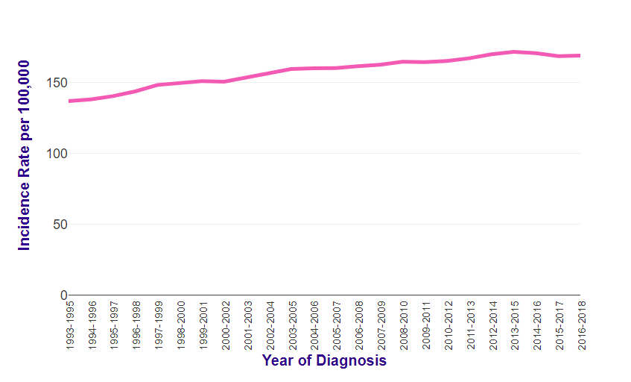
Breast cancer rates and survival over time

Slide 10
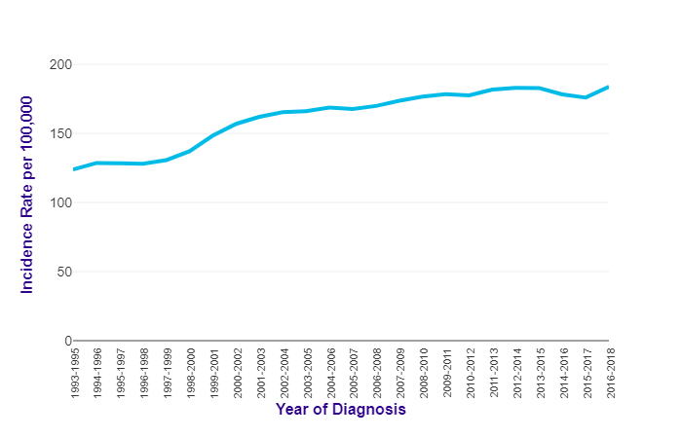
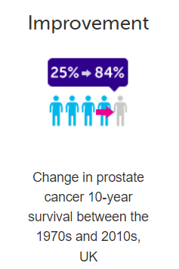
Prostate cancer rates and survival over time

Slide 11
Breast Cancer

Slide 12
Risk Factors
Previous history of breast cancer.
Family history of breast cancer in a first-degree relative. Between 6% and 19% of women will have a family history but this may be due to chance, shared environmental or lifestyle risk factors, or increased genetic susceptibility.
No Children, or having a first child after the age of 30 years.
Not breastfeeding
Early periods or late menopause
Radiation to the chest (even quite small doses).
The Western-style diet, obesity and the consumption of alcohol also contribute to the rising incidence of breast cancer.

Slide 13
Risk Factors
Hormone replacement therapy (HRT):
HRT with oestrogen alone is associated with little or no change in the risk of breast cancer.
HRT with oestrogen and progestogen can be associated with an increase in the risk of breast cancer.
Any increase in the risk of breast cancer is related to treatment duration and reduces after stopping HRT.
Combined oral contraception:
There is a small increase in the risk of having breast cancer diagnosed in women taking the combined oral contraceptive pill.
However, this relative risk may be due to an earlier diagnosis and the cancers are more likely to be localised to the breast.
The most important factor for diagnosing breast cancer appears to be the age at which the contraceptive is stopped rather than the duration of use.
Any increase in the rate of diagnosis diminishes gradually during the 10 years after stopping and disappears by 10 years.

Slide 14
BRCA

Slide 15
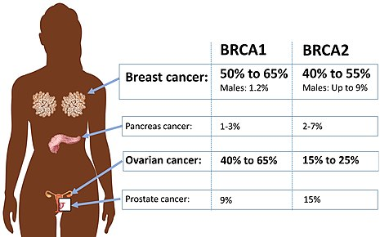
BRCA

Slide 16
Screening
Every 3 years
Aged 50-70
Can self refer after this age
Breast screening uses mammography radiography to detect small changes in the breast before other symptoms or signs of breast cancer develop.
If breast cancer is found at an early stage, there is an increased chance of breast-conserving surgery and a better prognosis for long-term survival.
Invitations for routine mammography screening are sent out to women aged 50–70 years (from the age of 50 years up to their 71st birthday) in England, Northern Ireland, Scotland, and Wales.

Slide 17
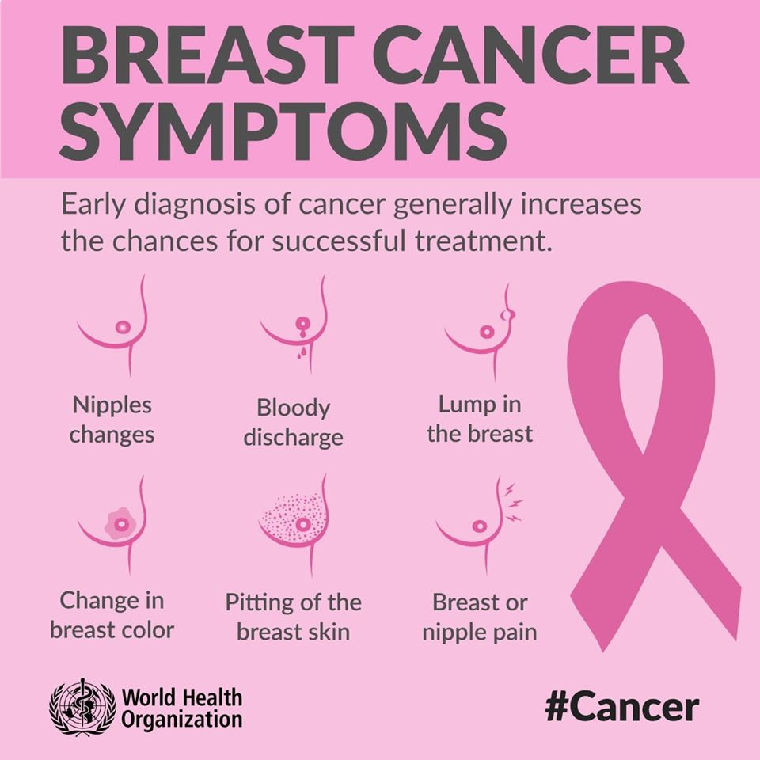
Symptoms

Slide 18
Treatment
Surgery
Radiotherapy
Chemotherapy
Hormone therapy

Slide 19
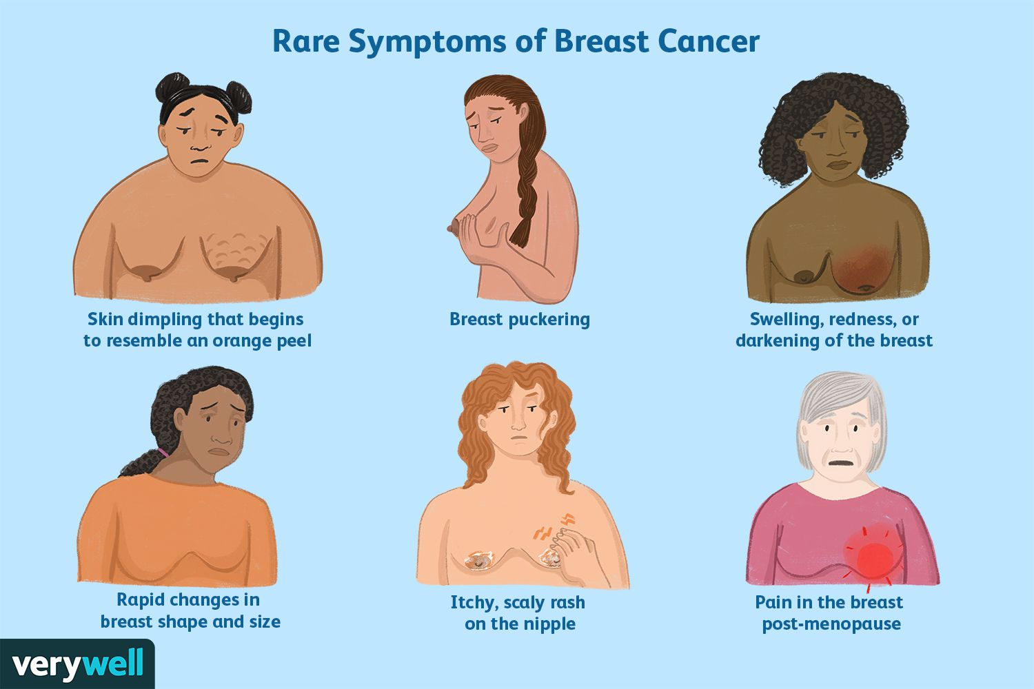

Slide 20
Should I worry about breast cancer if I’m a man?
In females in the UK, breast cancer is the most common cancer, with around 56,400 new cases every year (2017-2019).
In males in the UK, breast cancer is not among the 20 most common cancers, with around 390 new cases every year (2017-2019).
Most patients present having felt a lump, which is most often painless but may be associated with pain. Other presenting symptoms include nipple change, nipple discharge and skin changes. Breast pain/mastalgia alone is a very uncommon presentation. Intraduct carcinoma may present as a bloody discharge from the nipple.

Slide 21
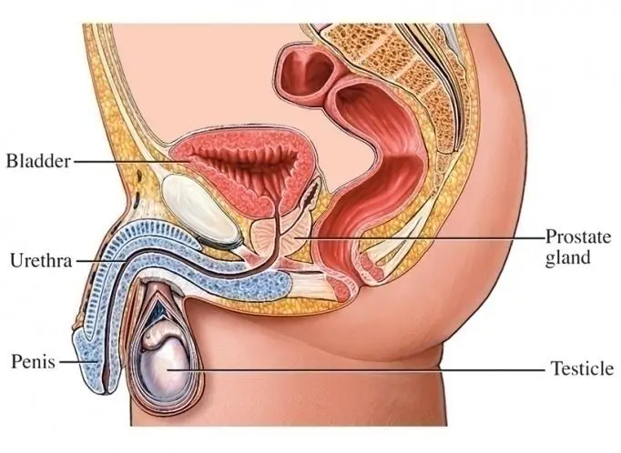
Prostate Cancer

Slide 22
Prostate Cancer Causes
Although the exact cause is unclear, certain risk factors increase the chance that prostate cancer may develop. These include:
Ageing. Most cases occur in older men.
Family history and genetic factors. If your father or brother had prostate cancer at a relatively early age (before the age of 60 years) then you have an increased risk. Also, if the type of breast cancer which is linked to a faulty gene runs in your female relatives then you are at increased risk of prostate cancer. These factors point towards a faulty gene which may occur in some men.
Ethnic group. Prostate cancer is more common in African-Caribbean men and less common in Asian men.
Obesity is a risk factor for advanced prostate cancer.
Diet is possibly a risk factor. As with other cancers, a diet high in fats and low in fruit and vegetables may increase the risk.

Slide 23
Prostate Cancer Symptoms
Poor stream. The flow of urine is weaker, and it takes longer to empty your bladder.
Hesitancy. You may have to wait at the toilet for a while before urine starts to flow.
Dribbling. A bit more urine may trickle out and stain your underpants soon after you finish at the toilet.
Urinary incontinence.
Frequency. You may pass urine more often than normal.
Urgency. You may have to get to the toilet quickly.
Poor emptying. You may have a feeling of not quite emptying your bladder.

Slide 24
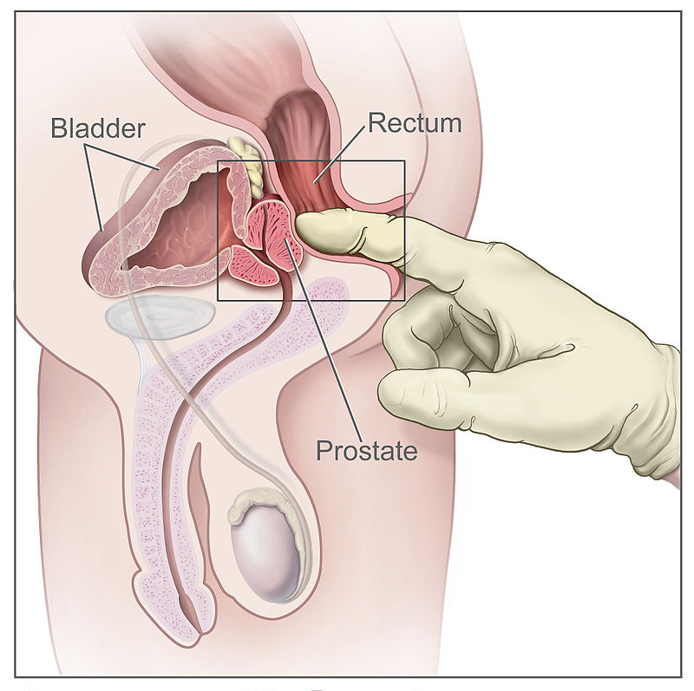
Prostate Cancer Tests
Digital Rectal Exam
PSA blood test

Slide 25
Prostate Cancer Treatment
Active surveillance: in some cases it may be best not to have any active treatment but to see how the cancer develops.
Surgery to remove the prostate.
Radiotherapy.
Hormone treatment

Slide 26
Should I get a PSA test - tiny.cc/PSAtest

Slide 27
Should I get a PSA test
Research has shown around 3 in 4 men with a raised PSA level will not have cancer, and around 1 in 7 men with prostate cancer would have a normal PSA result.Pros:
it may reassure you if the test result is normal
it can find early signs of cancer, meaning you can get treated early
PSA testing may reduce your risk of dying if you do have cancer
Cons:
it can miss cancer and provide false reassurance
it may lead to unnecessary worry and medical tests when there's no cancer
it cannot tell the difference between slow-growing and fast-growing cancers
it may make you worry by finding a slow-growing cancer that may never cause any problems

Slide 28
Should I get a PSA test
The answer to this question is not the same for everyone. Your doctor can help you decide based on your values and preferences.
The main test used to screen for prostate cancer is a blood test called a "PSA test." Doctors offer screening in the hopes of catching prostate cancer early – before it has a chance to grow, spread, or cause symptoms. But it is not clear if getting screened for prostate cancer can extend a man's life or help him avoid any symptoms or problems.
It might help to ask yourself the following questions when deciding whether or not to be screened:

Slide 29
Should I get a PSA test
The answer to this question is not the same for everyone. Your doctor can help you decide based on your values and preferences.
The main test used to screen for prostate cancer is a blood test called a "PSA test." Doctors offer screening in the hopes of catching prostate cancer early – before it has a chance to grow, spread, or cause symptoms. But it is not clear if getting screened for prostate cancer can extend a man's life or help him avoid any symptoms or problems.
It might help to ask yourself the following questions when deciding whether or not to be screened:

Slide 30
Should I get a PSA test
Am I at high risk for prostate cancer?
On average, 1 in 6 men will get prostate cancer. But some men are at higher risk, including Black men and men with a close relative who had the disease. If you're not sure, your doctor can help you figure out if you are at high risk.
Do I want to know if I have prostate cancer?
Some cancers found by screening tests are slow growing, and would not cause harm for many years or might never cause harm. That means you could go through treatment for a cancer that would not have caused you harm.
Some people feel better having as much information as possible. Other people prefer to take a "wait and see" approach. Think about which bothers you more – the possibility of not catching cancer as early as possible, or the risks that come with tests and treatments you might not otherwise have needed.

Slide 31
Should I get a PSA test
How do I feel about the possibility of getting a "false positive" result?
2 out of every 3 positive PSA tests end up being "false positives." This means the test suggests cancer when there is actually no cancer. This can lead to unneeded worry and extra tests, including a biopsy (see next question).
Other things besides cancer can cause a PSA test to be positive. These include an enlarged prostate, riding a bicycle, or ejaculating (having an orgasm) within a few days before the test.
Am I willing to have a prostate biopsy to check for cancer?
If your PSA test comes back positive, you might then need another test called a "biopsy" to look for cancer. This test can be painful and comes with some risk of infection.
Would I want to be treated if I learned I had prostate cancer?
For some men, "active surveillance" might be an option. Men who choose this option do not have treatment right away. But they do have routine tests to check whether the cancer starts to grow. If so, they can start active treatment then.
Some men wish to get treatment right away, or their doctors suggest treatment (rather than active surveillance) based on their cancer. Possible options include radiation and surgery.

Slide 32
Should I get a PSA test
How do I feel about the risks of being treated for prostate cancer?
The risks of treatments like radiation and surgery include problems with urinating, erectile function, and having bowel movements.
How would I feel about getting a serious (or even deadly) form of prostate cancer if I had decided not to get screened?
Although this is rare, it might help to think about whether you would regret not having done everything possible to find cancer early.

