Slide 1
Gender Pay Gap report
April 2024

Slide 2
Operose Health and Gender Pay Gap reporting
As an organisation who employs over 250 employees, we are legally required to publish a Gender Pay Gap Report annually for two of the entities within our Group – AT Medics Limited and The Practice Surgeries Limited (TPS).
To provide a full and transparent view of our organisation and our approach and commitment to closing the Gender Pay Gap, we have gone above our legal requirements and produced this additional report to provide greater clarification on our gender pay gap.
We are committed to closing and eradicating the gender pay gap and treating all colleagues equally and fairly.
To help close our gender pay gap, over the coming year we will be:
Promoting diversity across all of our workforce.
Continuing to do more to ensure our policies and processes support female progression and development.
We will review our policies and process to ensure that flexible working, menopause and women’s health are sufficiently well represented and actioned across our organisation.
We will be conducting an organisational development review which will allow us to review pay gaps and align where the opportunity is available.

Slide 3
Operose Health and Gender Pay Gap reporting
As an entire Group – 75% of our workforce is female and 25% male.
In 2023 the UK National Pay Gap was 14%.
The BMJ in 2020 released a report showing that the gender pay gap for GPs was 15.3%.
For all GPs across all the entities that make up our organisation, we have a pay gap of 3.3% which is significantly lower than the national average and that reported for GPs.
We understand that our gender pay gap for TPS appears to be an outlier at 55%.
This figure is because of the very small number of male colleagues within this entity (35 individuals) where 57% of these male colleagues are GPs and so are within the upper pay quartile.
0.6% of colleagues within TPS are male and working within the lower quartile roles, 10% of employees within TPS are male - which is representative of the healthcare industry.
Analysis of our job families within TPS shows that our
mean and medians are comparable to UK averages.
Whilst comparable, this is still something that as an
organisation we want to improve upon. Closing this gap is
a priority for our Executive and Senior Leadership Teams.
Job family | Mean | Median
Regional Medical Directors and Clinical Leads | 12% | 14%
Pharmacy roles | 9.8% | 10.7%

Slide 4
Operose Health and Gender Pay Gap reporting
We have also conducted job family gender pay reviews across the entire organisation.
We are pleased to say that these are significantly lower than NHS and BMJ data comparisons.
Further details of AT Medics Limited and The Practice Surgeries Limited’s Gender Pay Gap reporting can be found below.
Please note:
All data in this report is reflective of our workforce on the reporting date of 5th April 2023.
This report is based on legal gender categories, but we acknowledge that our people may identify differently.
Job family | Mean | Median
GP | 3.3% | 1.58%
Pharmacy roles | 9.74% | 10.2%
Regional Medical Directors and Clinical Leads | 12.84% | 8.41%

Slide 5
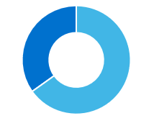
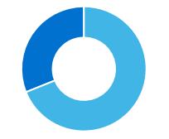
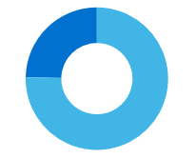
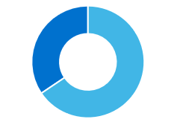
AT Medics summary
AT Medics Limited employed 953 people on the date of reporting – 69% of these employees are female and 31% are male.
Proportion of female and males in each quartile and hourly pay
Our mean
13.9%
34%
31%
25%
35%
Lower
Lower middle
Upper middle
Top
66%
69%
75%
Our median
-3.86%
65%
Male
Female
A minus hourly pay gap indicates that the pay gap is in favour of females, a positive figure means the pay gap is in favour of males.
AT Medics has not given bonuses for the 2023 reporting year and therefore there is not data to report.

Slide 6
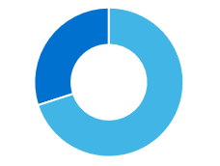

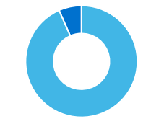
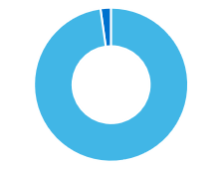
The Practice Surgeries summary
The Practice Surgeries Limited employed 362 people on the date of reporting – 90% of these employees are female and 10% male.
Proportion of female and males in each quartile and hourly pay
Our mean 55.91%
2%
7%
30%
Lower
Lower middle
Upper middle
Top
98%
100%
93%
Our median
74.07%
70%
Male
Female
A minus hourly pay gap indicates that the pay gap is in favour of females, a positive figure means the pay gap is in favour of males.
The Practice Surgeries has not given bonuses for the 2023 reporting year and therefore there is not data to report.

