Slide 1
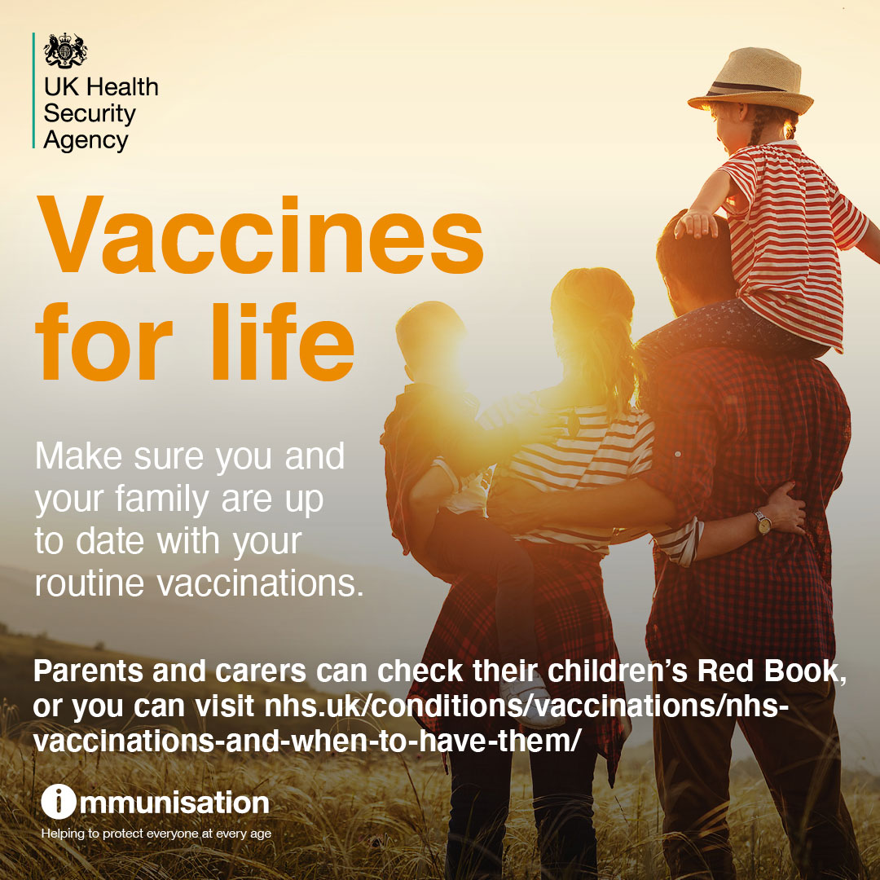

Slide 2
Influenza
الانفلونزا
ইনফ্লুয়েঞ্জা
Mumps
النكاف
মাম্পস
Diphtheria
الخناق
ডিপথেরিয়া
Tetanus
كُزاز
টিটেনাস
Polio
شلل الأطفال
পোলিও
COVID
فيروس كورونا
কোভিড
What diseases are currently spreading in London?
Whooping Cough
السعال الديكي
হুপিং কাশি
Measles
مرض الحصبة
হাম
Hepatitis
التهاب الكبد
হেপাটাইটিস
Shingles
هربس نطاقي
দাদ

Slide 3
When were the vaccines started?

Slide 4
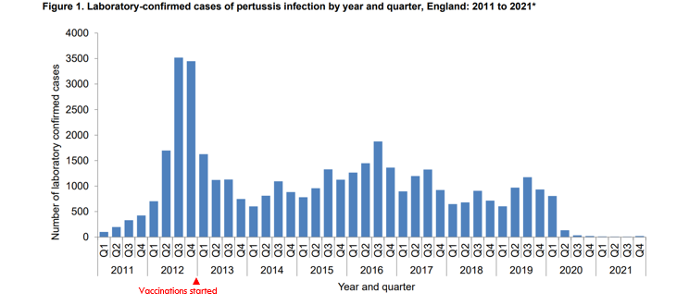
How have vaccines impacted diseases in London?
As shown in the previous picture, pertussis vaccination for pregnant women started in 2012. Here it is a graph that shows how this affected the number of cases

Slide 5
Why is it important that people get vaccinated?
Vaccines are the most effective way to prevent infectious disease. They can protect adults and children from potentially life changing or life threatening diseases.
The more people vaccinated the more people protected – this is known as ‘herd immunity’ which is considered as group immunity
In order for a population to achieve herd immunity, 95% of the individuals will need to get vaccinated.
Herd immunity or group immunity is important as not everyone can be vaccinated, and therefor protected. Some of this people are:
People allergic to vaccines
People on active chemotherapy
People with immunodeficiencies
I’m protected

Slide 7
Influenza
الانفلونزا
ইনফ্লুয়েঞ্জা
Mumps
النكاف
মাম্পস
Diphtheria
الخناق
ডিপথেরিয়া
Tetanus
كُزاز
টিটেনাস
Polio
شلل الأطفال
পোলিও
COVID
فيروس كورونا
কোভিড
What diseases are currently spreading in London?
Whooping Cough
السعال الديكي
হুপিং কাশি
Measles
مرض الحصبة
হাম
Hepatitis
التهاب الكبد
হেপাটাইটিস
Shingles
هربس نطاقي
দাদ

Slide 10
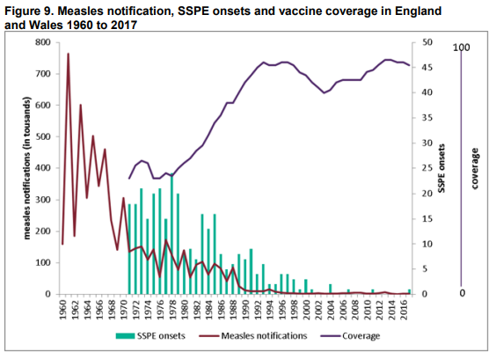
How have vaccines impacted diseases in London?
This graph shows the rates of Measles reported from 1960 (red line).
From 1970 we can see the incidence of serous complications from Measles (Light blue lines).
From 1970 we can also see the rate of Measles vaccines (dark blue line).
As you can see the rates of Measles and serious complications from measles have gone down as the vaccine rates have gone up.

Slide 11
What does Measles look like?
Fever
Dry cough
Conjunctivitis, or swollen eyelids and inflamed eyes
Runny nose
Sneezing
A reddish-brown skin rash- starts from head and spreads to whole body
A run-down or lethargic feeling
Loss of appetite
Watery eyes
Photophobia, or sensitivity to light
Generalised body aches

Slide 12
What are the complications of Measles?
Blindness
Encephalitis (an infection causing brain swelling and potentially brain damage)
Severe diarrhoea and related dehydration
Ear infections causing hearing problems
Severe breathing problems including pneumonia.
Most deaths from measles are from complications related to the disease.
If a woman catches measles during pregnancy, this can be dangerous for the mother and can result in her baby being born prematurely with a low birth weight.

Slide 13
What does Mumps look like?
Swelling in one or both parotid glands, leading to puffed out cheeks
Pain and swelling in the groin area
Fever
Headache
Muscle ache
Loss of appetite
Weakness and/or fatigue
Pain during chewing or swallowing

Slide 14
What are the complications of Mumps?
Although rare, Mumps can occasionally cause complications, especially in adults.
Inflammation of the testicles (orchitis); this may lead to a decrease in testicular size (testicular atrophy)
Inflammation of the ovaries (oophoritis) and/or breast tissue (mastitis)
Inflammation in the pancreas (pancreatitis)
Inflammation of the brain (encephalitis)
Inflammation of the tissue covering the brain and spinal cord (meningitis)
Deafness
Inflammation of the testicles could lead to temporary sterility or decrease fertility in men, but no studies have assessed if it results in permanent infertility.

Slide 15
What does Rubella look like?
Rash that appears on the face, and then spreads downward to the rest of the body
Mild fever or malaise
Headache
Enlarged neck lymph nodes
Eye redness
Red rashes
Runny nose
Joint pain

Slide 16
What are the complications of Rubella?
Rubella is very dangerous for a pregnant woman and her developing baby and can lead to Congenital Rubella Syndrome.
This can cause baby to be born with:
Deafness
Cataracts
Heart defects
Intellectual disabilities
Liver and spleen damage
Low birth weight

Slide 17
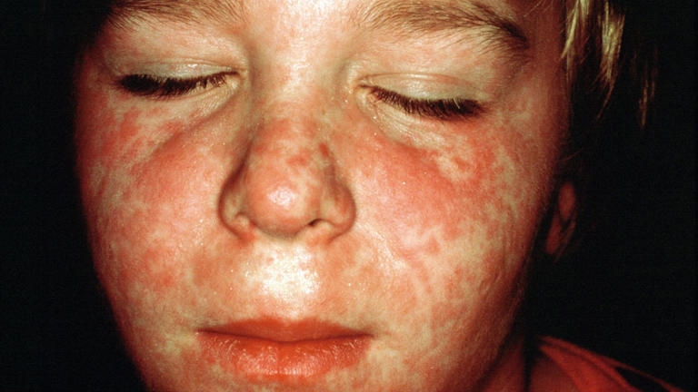
Measles Outbreak
Break out of Measles all over England are being seen in 2024
12% of all cases have been in London
This is due to low vaccination levels and we can avoid children being unwell if we vaccinate as soon as possible!
The MMR vaccine is very safe and effective. Two doses of MMR vaccine are about 97% effective at preventing measles;
one dose is about 93% effective.

Slide 19
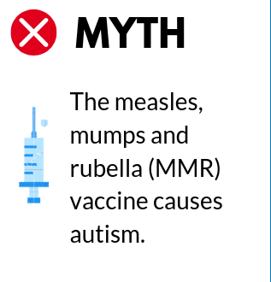
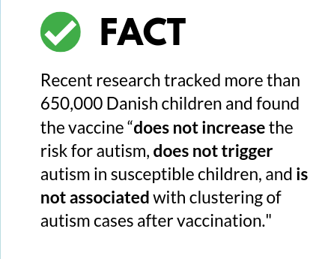
MMR Vaccine

Slide 20
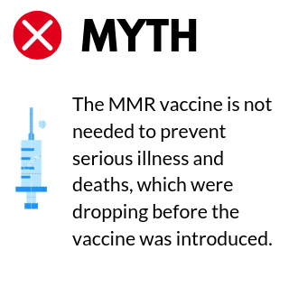
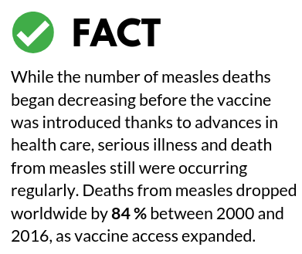
MMR Vaccine

Slide 21
MMR Vaccine
This is a very common misconception, but actually the MMR vaccine has never contained mercury. There is more mercury in a can of mackerel in tomato sauce, than in a vaccination shot.
The MMR vaccine contains Mercury

Slide 22
MMR Vaccine
The immune system handles much more every day; the MMR vaccine is a tiny addition.
Getting three vaccines at once overloads the immune system

Slide 24
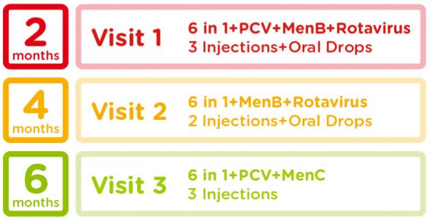
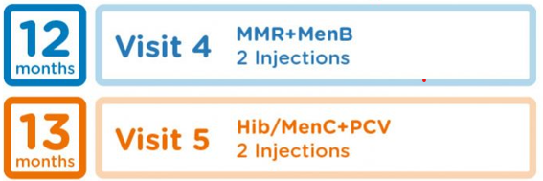
When are vaccines due again?
2
Diphtheria, Polio, tetanus, Hepatitis B, Haemophilus B and Pertussis + Meningitis B + Rotavirus
2 Injections and one oral
3
Diphtheria, Polio, tetanus, Hepatitis B, Haemophilus B and Pertussis + Pneumococcal + Rotavirus
2 Injections and one oral
4
Diphtheria, Polio, tetanus, Hepatitis B, Haemophilus B and Pertussis + Meningitis B
2 Injections
12
Pneumococcal + Meningitis B + Haemophilus B + MMR
4 Injections
40
Diphtheria, Polio, Tetanus and Pertussis + MMR
2 Injections

Slide 25
These aren’t the only vaccines we offer!
From 2 years old
12 to 14 years
70 to79 years
Diphtheria, tetanus, and polio (teenage booster)
Human papilloma Virus (HPV)
Meningococcal groups A, C, W and Y
Influenza (each year from September until March)
Pregnant people, or those thinking about becoming pregnant are eligible for vaccines too
All ages
Shingles Vaccine
Pregnant Women
Travel Vaccines

Slide 26
The flu vaccine helps protect against flu, which can be a serious or life-threatening illness.
It's offered on the NHS every year to people at higher risk of getting seriously ill from flu.

Slide 27
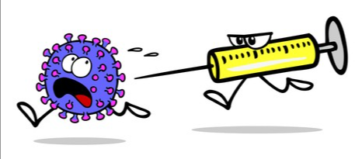
You can get the free NHS flu vaccine if you are:
Aged 65 or over (including if you will be 65 by 31 March 2024)
Have certain long-term health conditions
Pregnant
Live in a care home
The main carer for an older or disabled person, or receive a carer's allowance
Live with someone who has a weakened immune system

Slide 28
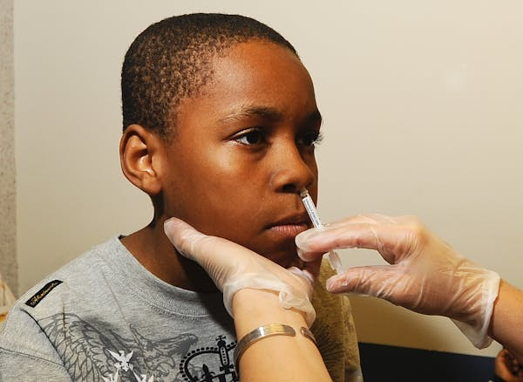
Children aged 2-17 are able to have the flu vaccine as a nasal spray!
This means no scary injection!
We do also offer alternatives if your child is not able to have the vaccine this route for any reason.

Slide 29
Aged between 12-24?
Travelling and going to university
You may be due a vaccine too!

Slide 31
Human Papilloma Virus (HPV) Vaccination
This vaccine is usually offered in school but if missed they can request it at their GP Practice
Girls under 25 and boys born after 1 September 2006 are all eligible for a FREE HPV vaccine.
The HPV vaccine can prevent over 90% of cancers caused by HPV.

Slide 32
Human Papilloma Virus (HPV) Vaccination
HPV infections can cause certain types of cancers, including:
Cervical, vaginal, and vulvar cancers in women
Penile cancer in men
Anal cancers in both men and women
Cancers of tonsils, base of tongue, and back of throat (oropharyngeal cancer) in both men and women
HPV infections can also cause genital warts.
HPV infections are so common that nearly all people will get at least one type of HPV at some time in their lives. Most HPV infections go away on their own within 2 years. But sometimes HPV infections will last longer and may cause cancers later in life

Slide 34
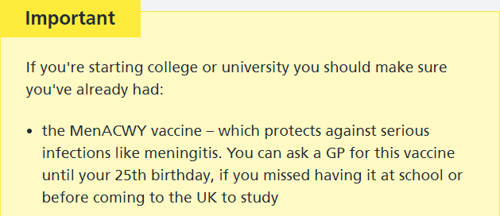
The Men A, C, W & Y vaccine
The Men ACWY vaccine is given by a single injection into the upper arm and protects against 4 strains of the meningococcal bacteria – A, C, W and Y – which cause meningitis and blood poisoning (septicaemia). It is highly effective in preventing illness caused by the 4 meningococcal strains, including the extremely harmful Men W strain.
Older teenagers and new university students are at higher risk of infection because many of them mix closely with lots of new people, some of whom may unknowingly carry the meningococcal bacteria at the back of their nose and throat.
Anyone who is eligible for the Men ACWY vaccine should have it, even if they have previously had the Men C vaccine.

Slide 35
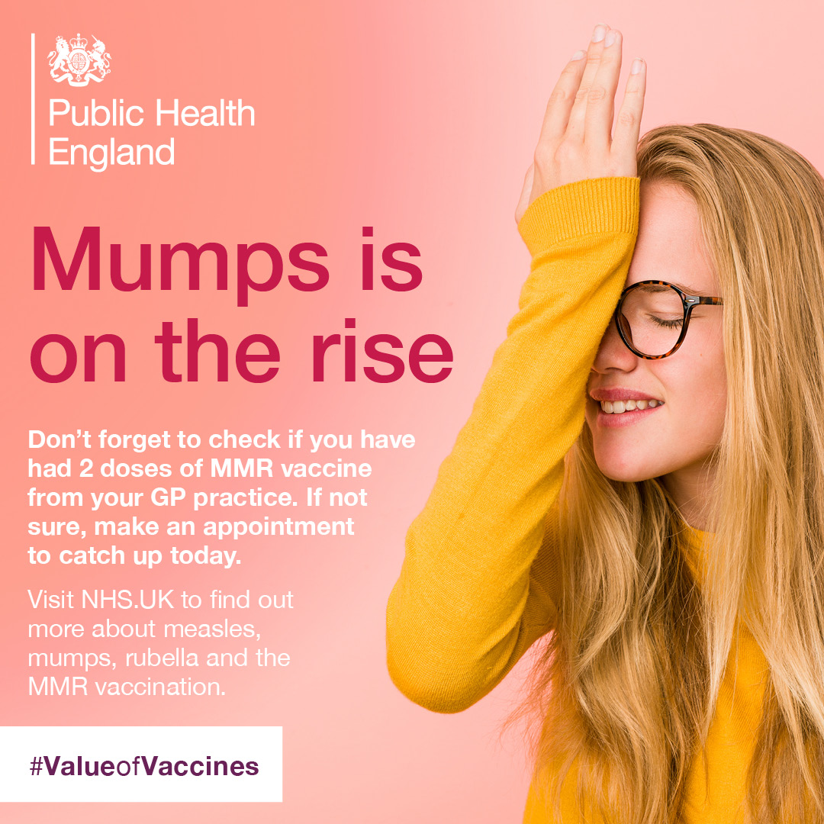

Slide 36
Planning on going away on holiday?
Make sure you can enjoy your time,
check if you need any vaccines before going!

Slide 37
Wherever you are planning on going on holiday
Your nurse can check to make sure you have the best chance of staying healthy so you can keep enjoying your time off

Slide 40
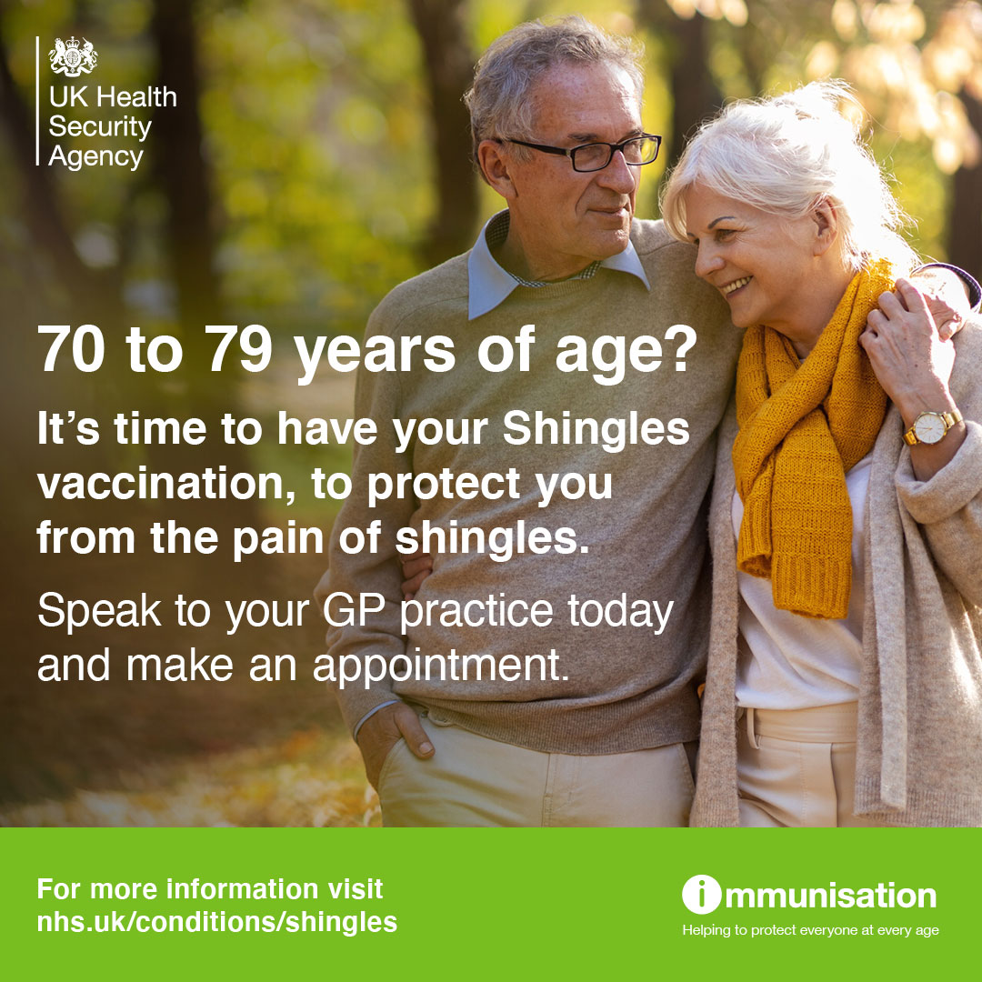

Slide 41
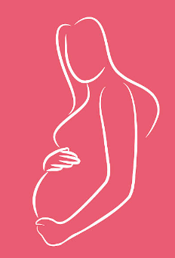

Slide 42
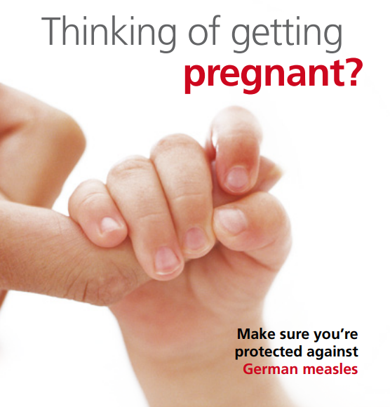
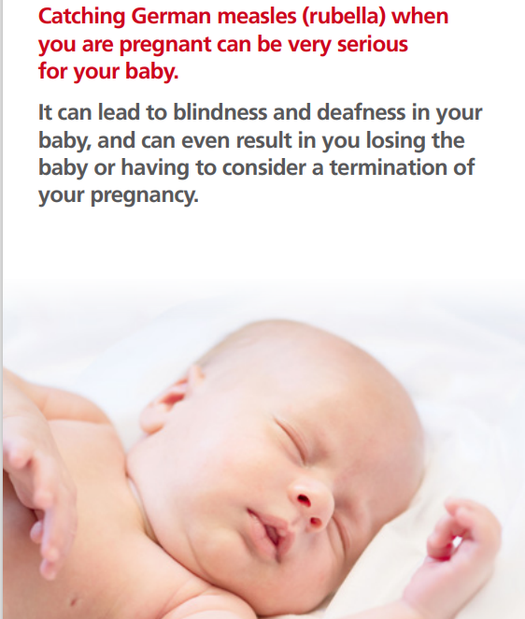

Slide 43
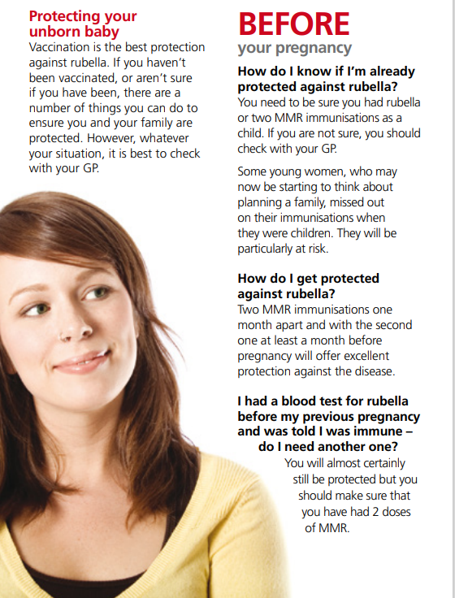
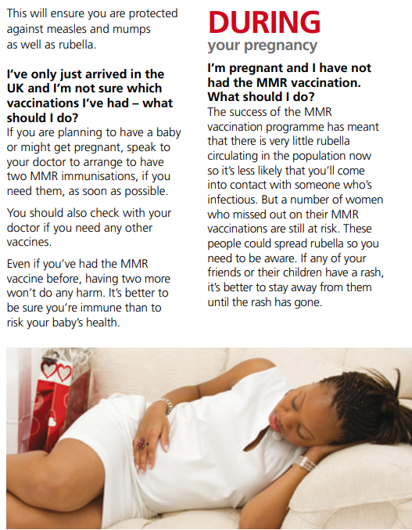

Slide 44
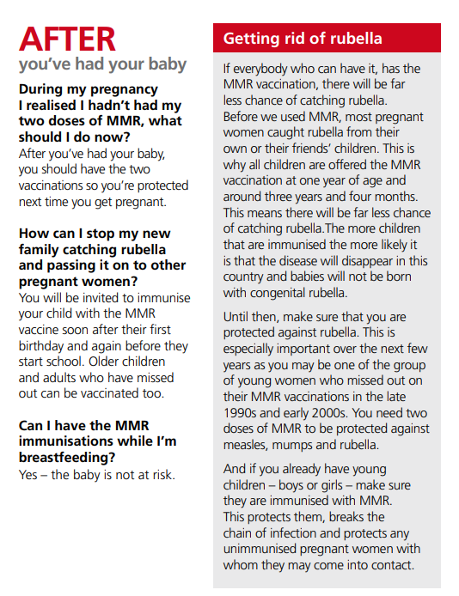
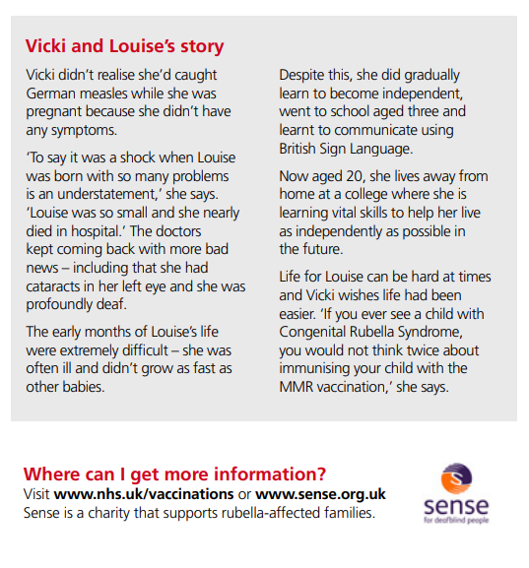

Slide 45
